Slide 1
Adding atrophy to VA AUC models
Adam Shah

Slide 2
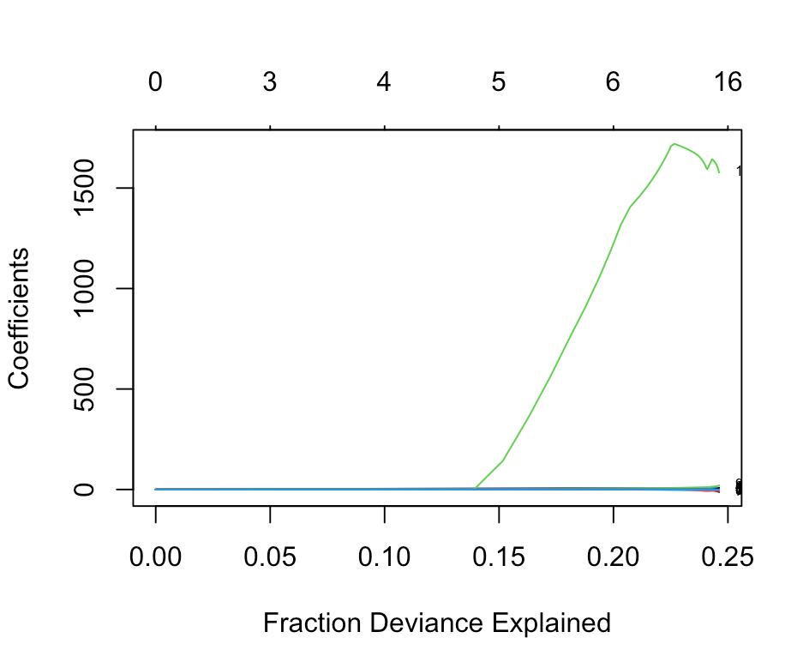
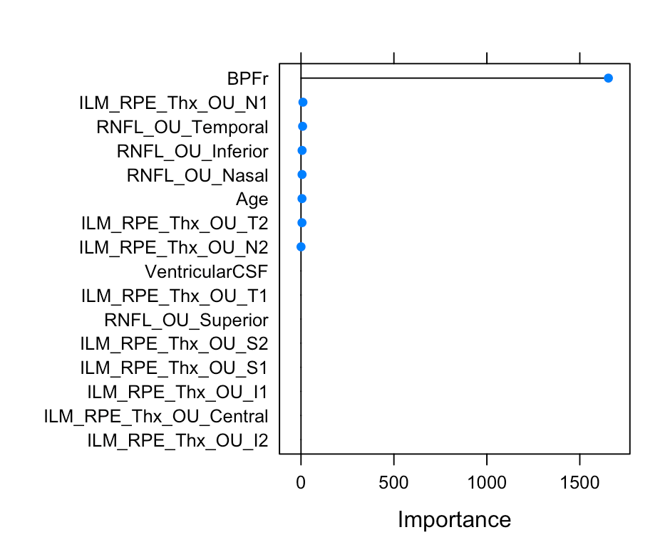
Adding atrophy to binocular model

Slide 3
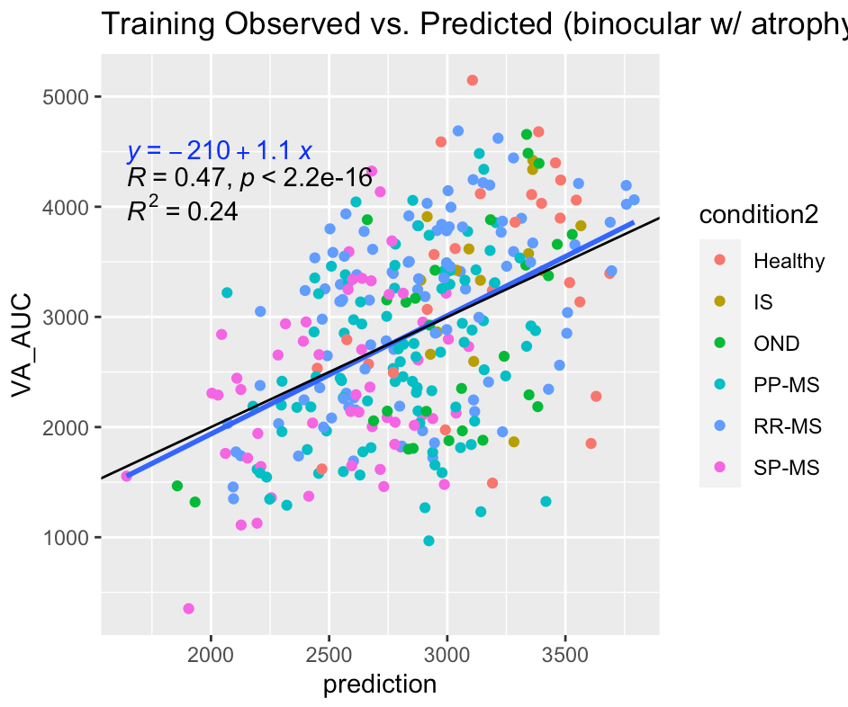
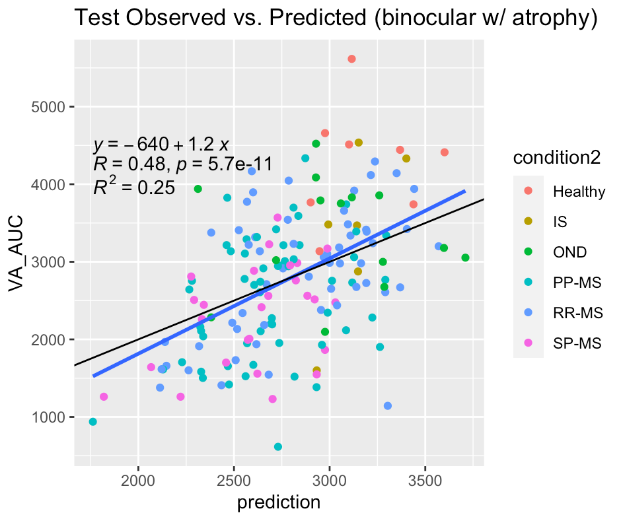
Validity of model w/ atrophy measures
*previous R^2 values were 0.25 and 0.22 respectively

Slide 4
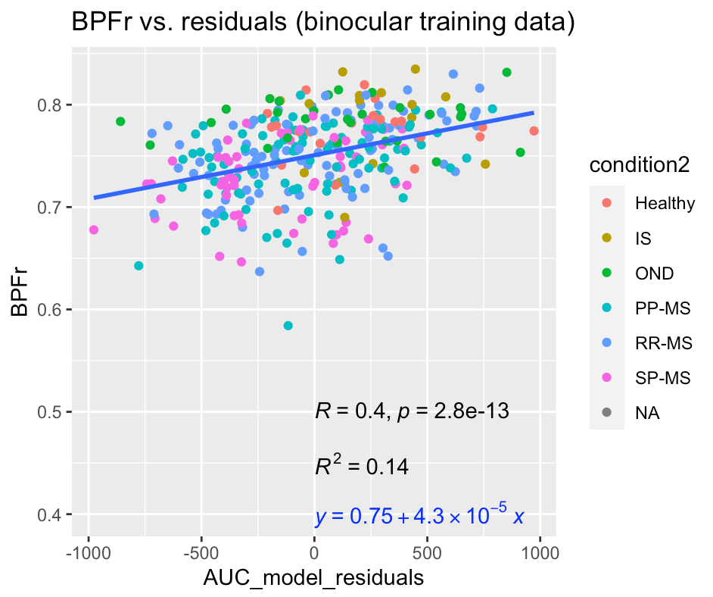
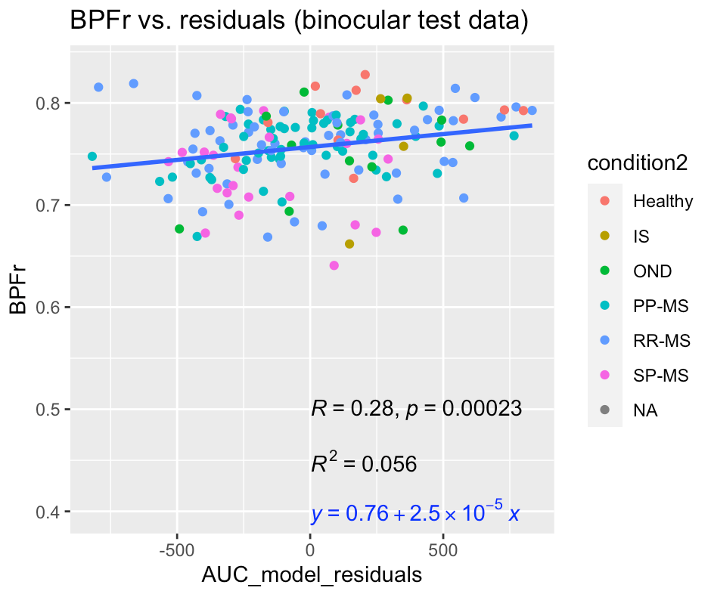
BPFr to explain residuals in original binocular model

Slide 5
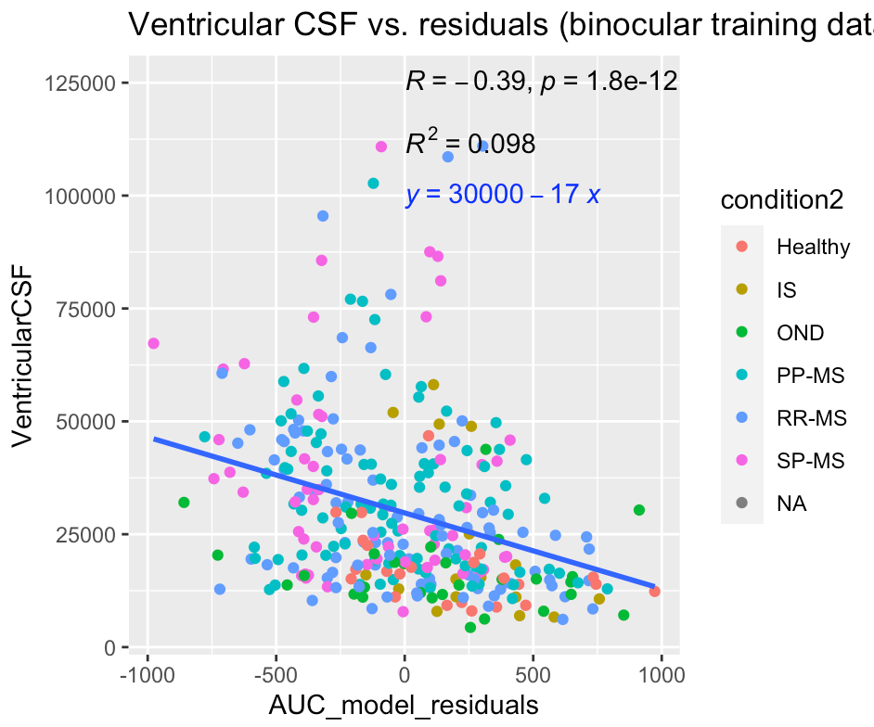
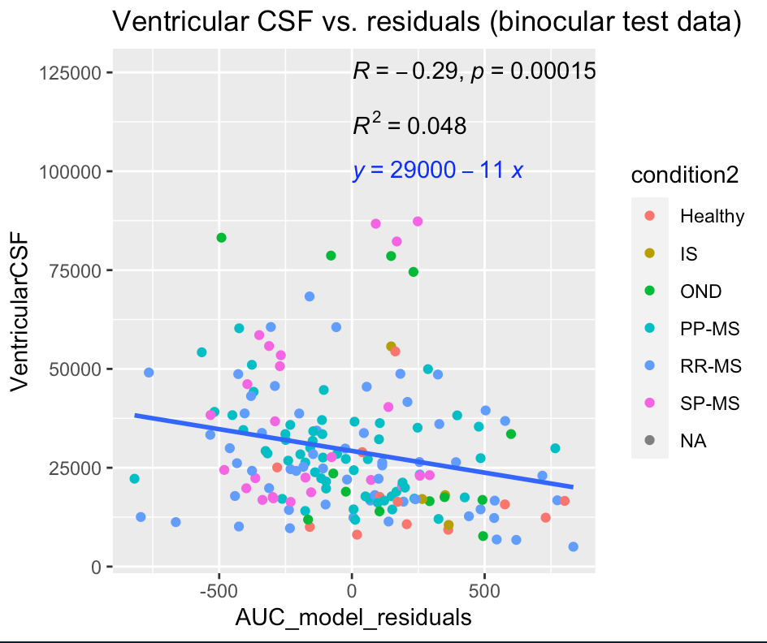
Ventricular CSF to explain residuals in original binocular model

Slide 6
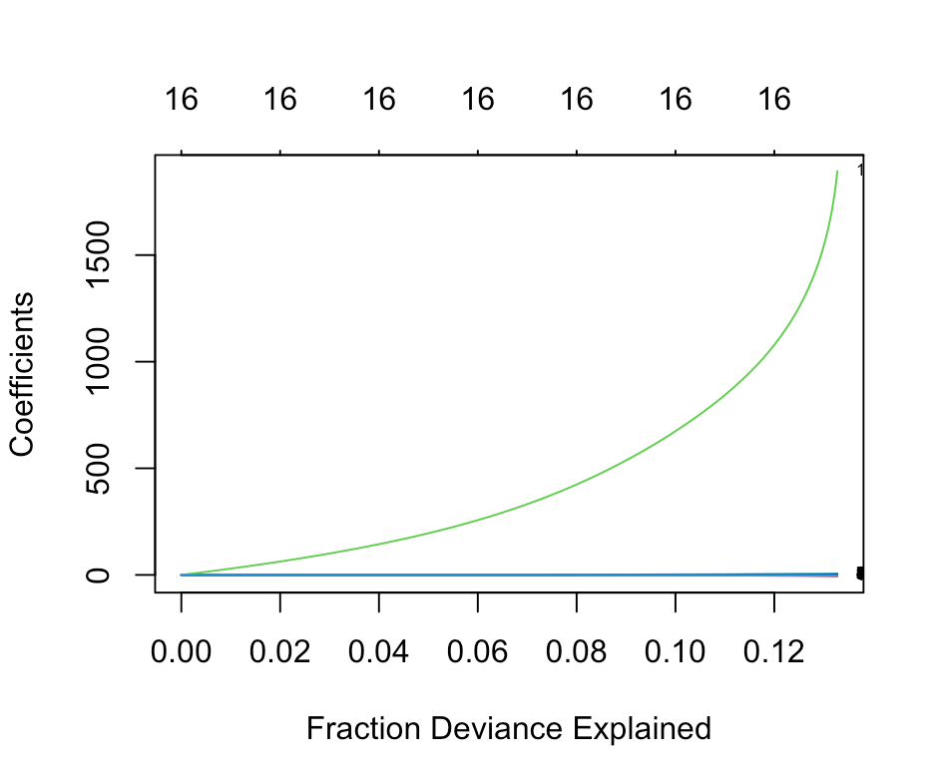
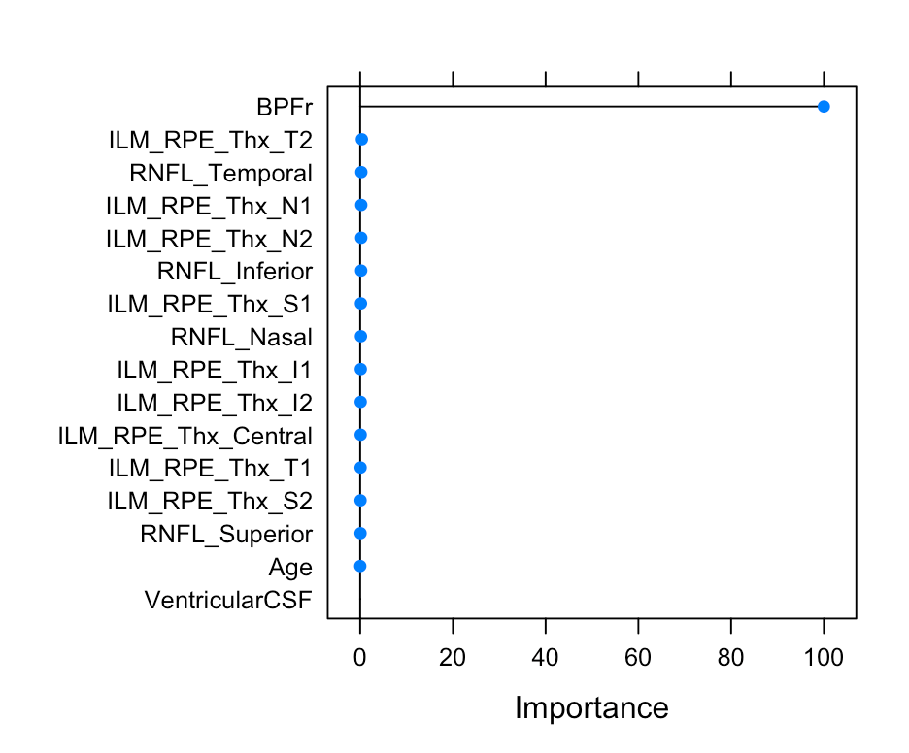
Adding atrophy to monocular model

Slide 7
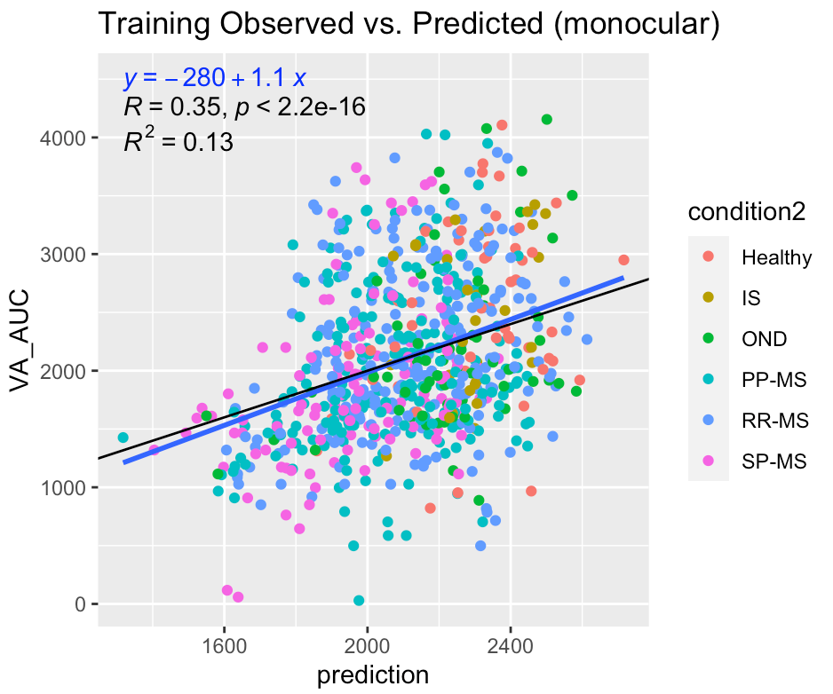
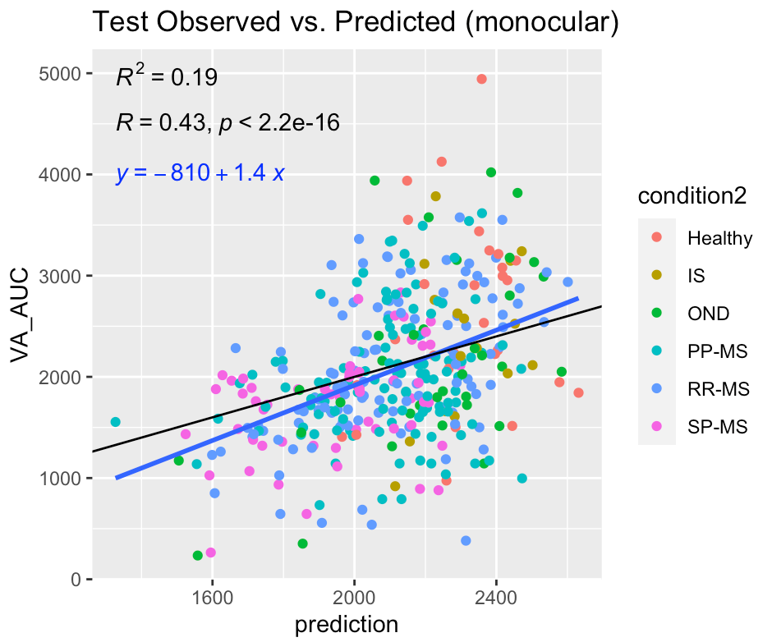
Validity of model w/ atrophy measures
*Previous R^2 values were 0.14 and 0.13 respectively

Slide 8
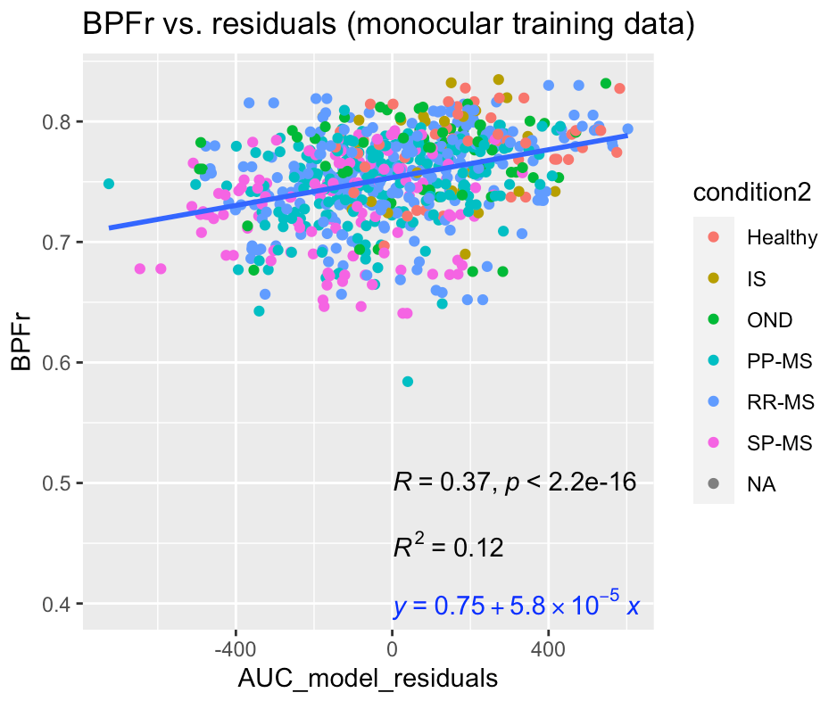
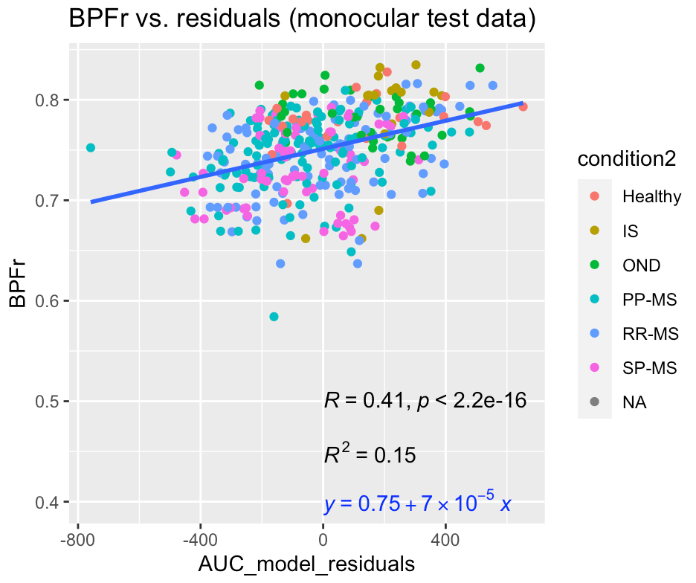
BPFr to explain residuals in original monocular model

Slide 9
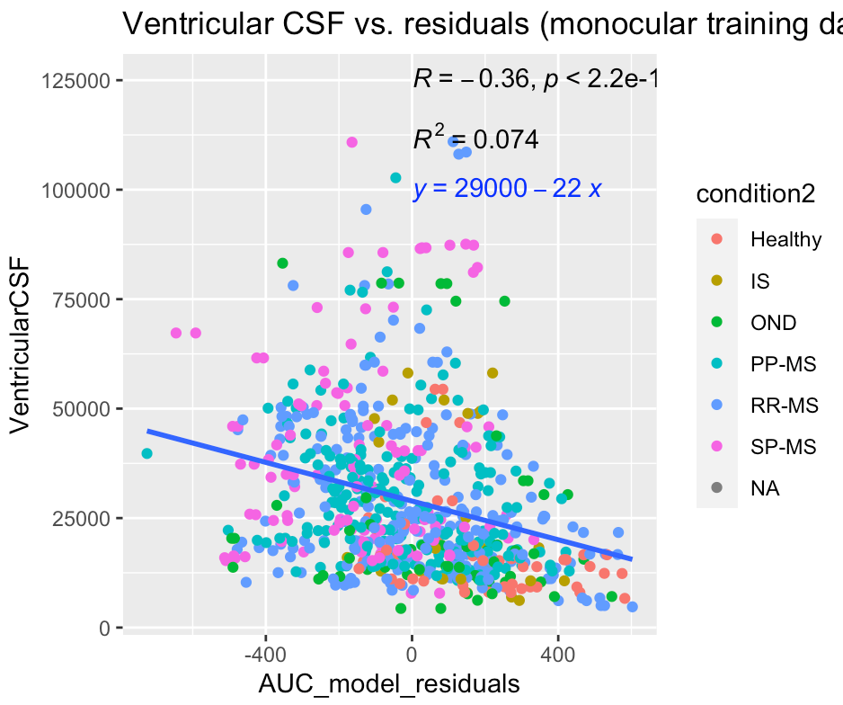
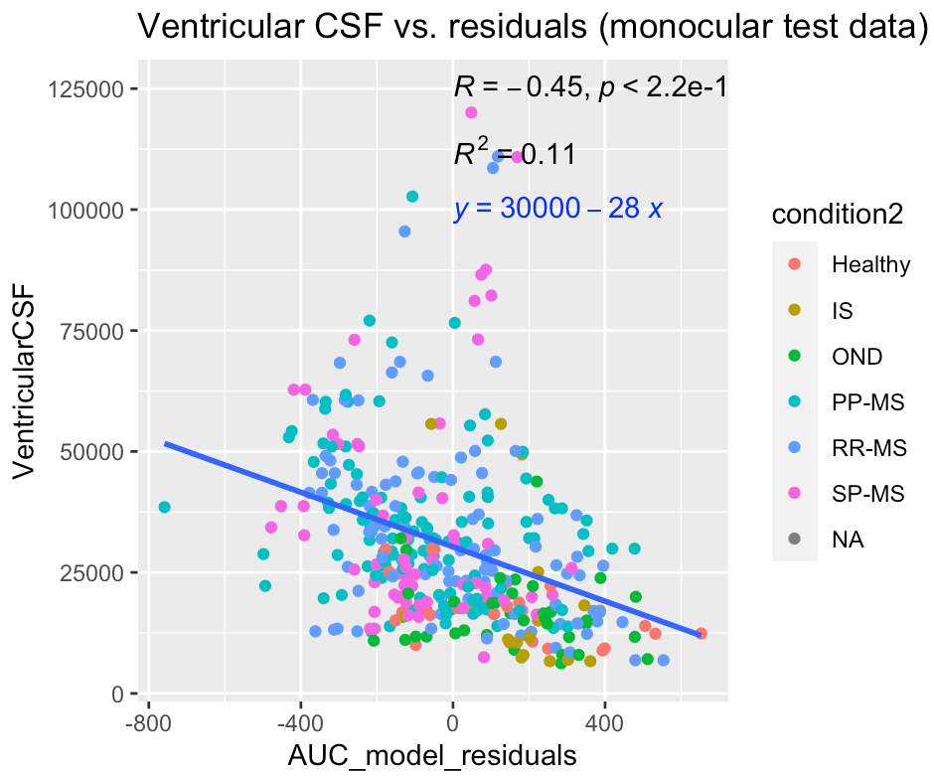
Ventricular CSF to explain residuals in original monocular model

